Slide 1

B18 Lesson 9
Bishop Stopford School
faith | justice | responsibility | truth | compassion
ONLINE LEARNING
Learning Objectives
Retrieval
Acquire
Action
Review
Dig Deeper

Slide 2
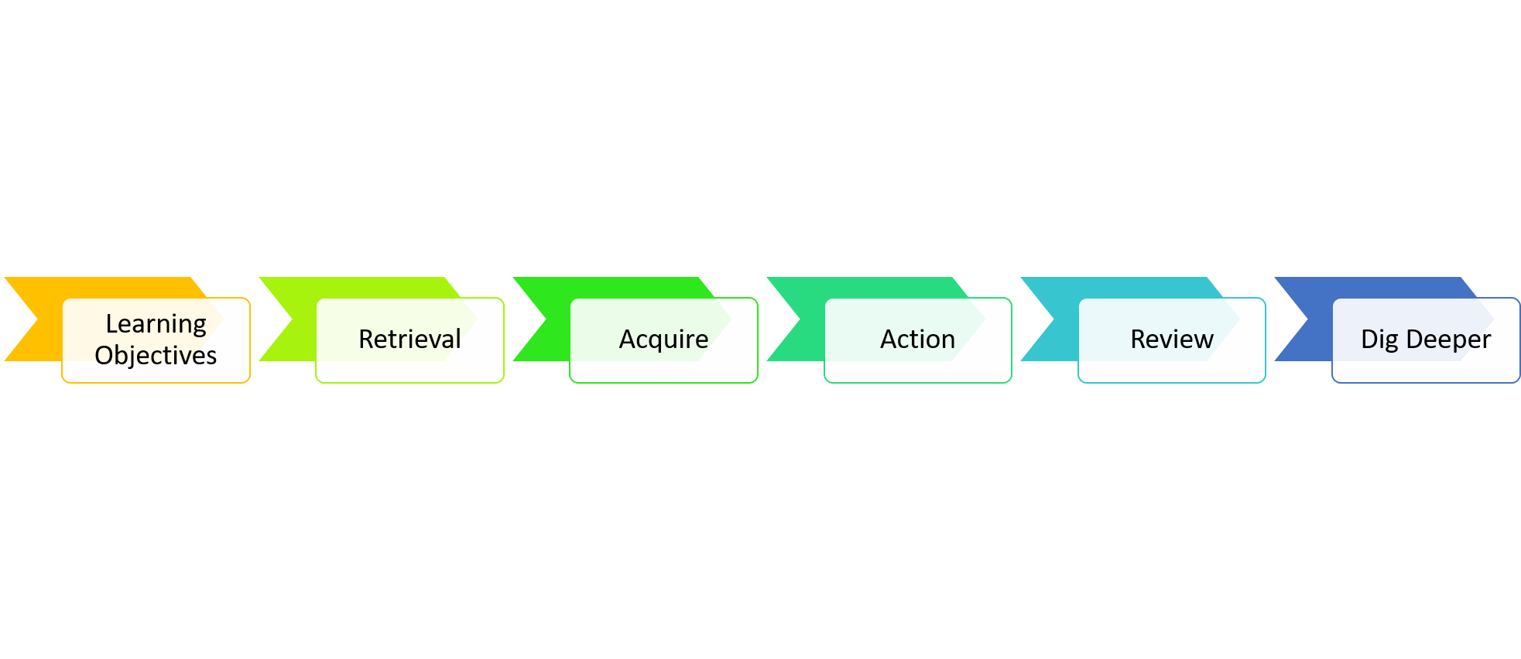
B18 Assessment Lesson
Learning Objectives
To assess and reflect on your understanding of B18

Slide 3
Starter: Last bit of revision
Complete the Kerboodle interactive revision activities:
https://www.kerboodle.com/app/courses/19899/modules/Resources/node/15485/page/1/content/154389,154391,154387,154390,154395,154396,154394,154392,154457,168227,154393,154388,154479,154458

Slide 4
B18 End of Chapter Test
The test is a 40 minute test
The test should be completed in exam conditions.
You can either print off the test or just answer the questions in your book.
We can not monitor that you stick to the time and exam conditions for this test. However, it is important for you to do this test properly so that you can check how you are doing and so we can monitor your progress.
Follow this link to the Test paper:
https://bishopstopford.fireflycloud.net/science-2/school-closure-tasks/year-10-1/biology/triple/b18-assessment-triple/b18-end-of-chapter-test-triple

Slide 5
B18 Test Self Assessment
Use the mark scheme to mark the test and give yourself a score out of 35
MS: https://bishopstopford.fireflycloud.net/science-2/school-closure-tasks/year-10-1/biology/triple/b18-assessment-triple/b18-end-of-chapter-test-markscheme-triple
2) Fill in the feedback form. This form will let you know what your WWWs and EBIs for the test are and will give you targeted MRIs to complete.
Feedback Form: https://bishopstopford.fireflycloud.net/science-2/school-closure-tasks/year-10-1/biology/triple/b18-assessment-triple/b18-test-feedback-triple
Due Monday 22nd
Your teachers will be checking that that this work has been completed by checking the feedback form has been completed.

Slide 6
Dig deeper (optional)
Complete the 6 mark extended exam question.
Your teacher will then mark this and provide you with feedback:
https://bishopstopford.fireflycloud.net/science-2/school-closure-tasks/year-10-1/biology/triple/b18-assessment-triple/dig-deeper-6-marker-optional-

